Slide 1
Notes:
Place Logo/ On Blue background

Slide 2
The North American Division
Office of Education
in collaboration with
Kendall Hunt Religious Publishing
are developing a new grades 1-8
faith-based inquiry science program.
Notes:
SDA Logo to top and make stronger – Glowing logo?

Slide 3
By Design Science for Grades 1-8
By Design: A Journey to Excellence through Science is your new faith-based inquiry science program for grades 1-8. This engaging, rigorous, and developmentally appropriate curriculum nurtures a child’s natural curiosity as they explore the wonderment of God’s creation through the lens of the Bible.
Notes:
Slide 8 from pp #1 KH

Slide 4
By Design Science for Grades 1-8
By Design is innovative and multi-dimensional in content and organization by offering a balanced and integrated development of science and health within the framework of the Adventist worldview.
Notes:
Slide 9 from pp # 1 KH

Slide 5
By Design Science for Grades 1-8
By Design focuses on the users’ experience so that all elements of the design invite, engage, instruct, and motivate students and teachers to continue learning and building their science knowledge, as well as strengthen their connections with their Creator.
Notes:
Slide # 10 pp 1 KH

Slide 6
By Design Science for Grades 1-8
By Design has a strong foundation based on a 5-step instructional model. This teaching model is used to promote inquiry-based learning and to stimulate a natural desire for knowledge and better understanding of God’s creation.
Notes:
Slide # 11 from pp 1KH

Slide 7
By Design Science for Grades 1-8
5-Step Instructional Model

Slide 8
By Design Science for Grades 1-8
Each grade level is organized by four units*:
Unit 1: Life Science
Unit 2: Human Body
Unit 3: Earth and Space Science
Unit 4: Physical Science
*Health is integrated within each unit, chapter, and lesson. Within the program each unit is broken into chapters and the chapters are broken into lessons.

Slide 9
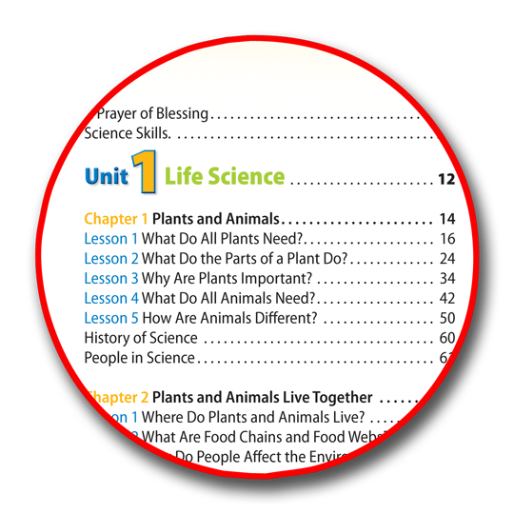
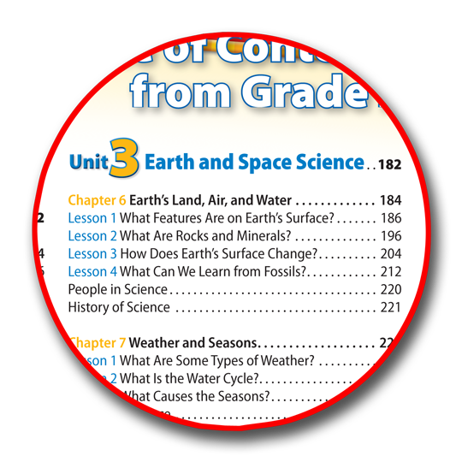
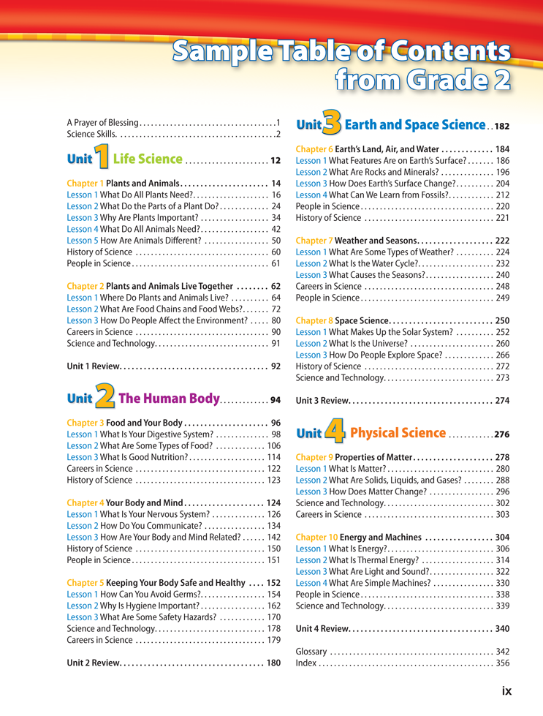
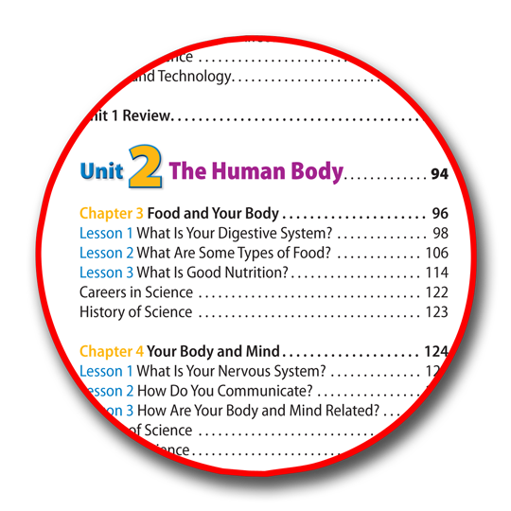
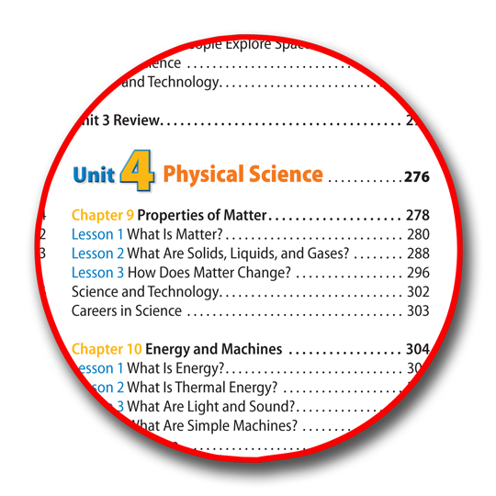
Notes:
Show sample TOC and call out the units….highlight

Slide 10
By Design Science for Grades 1-8
Within the program each unit is organized into chapters containing lessons. Many opportunities to explore and experiment with science are provided throughout. You will find the science and health content developed through lessons that connect these concepts to your faith and reflect the Adventist worldview.
Notes:
Pick up slide # 14 from KH 1

Slide 11
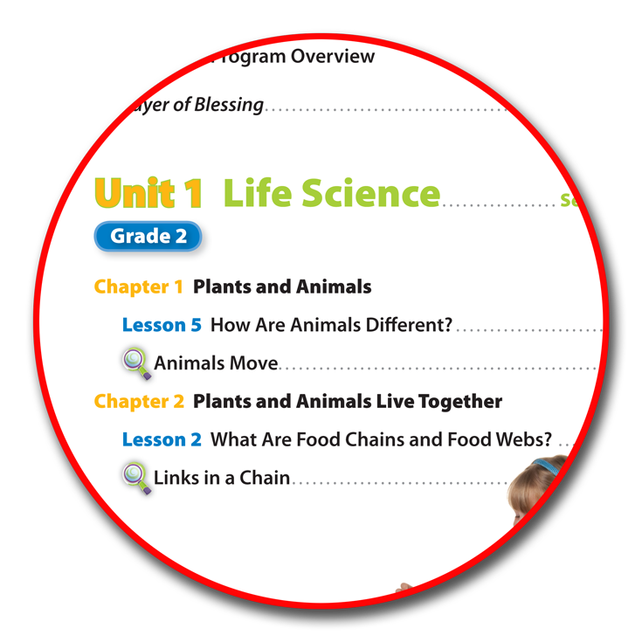
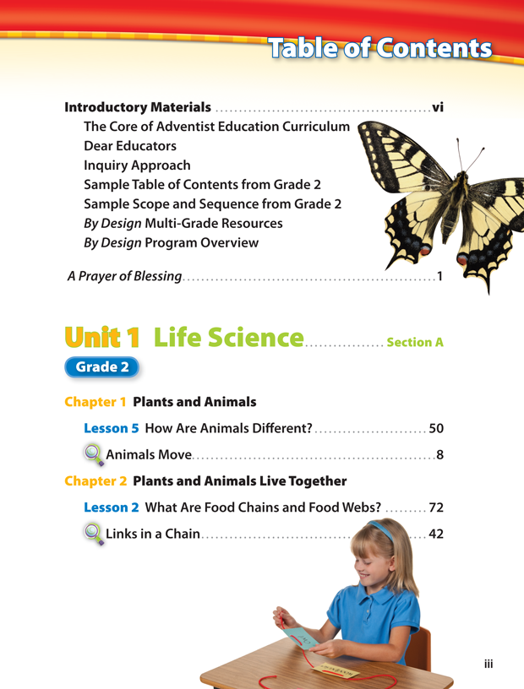
Sample Table of Contents
Notes:
Header sample Table of Contents – Magnify Unit 1 Life Science

Slide 12
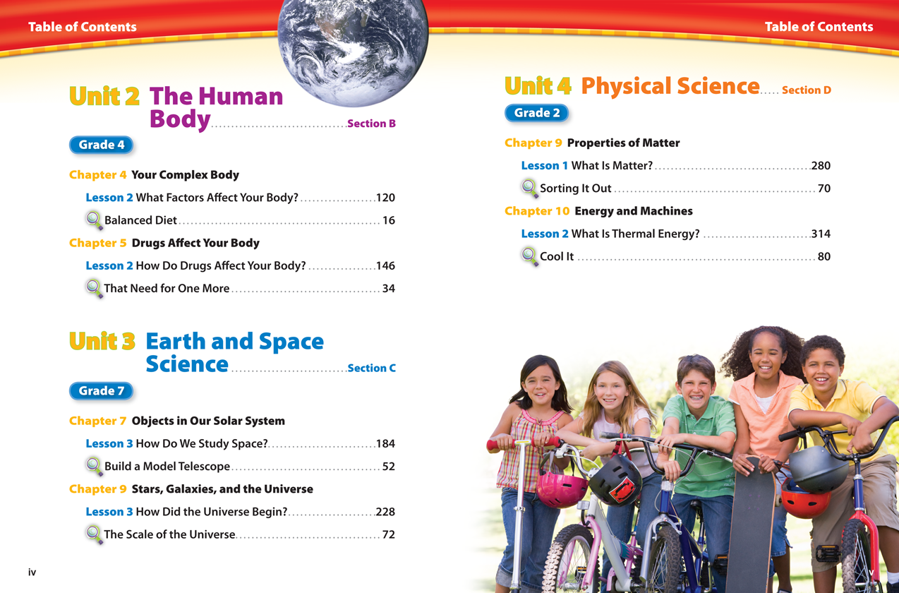
Notes:
Insert Spread iv and v

Slide 13
By Design Science for Grades 1-8
By Design is a complete science curriculum for grades 1-8. Components included:
Student Edition
Student Science Journal
Teacher Edition
Additional Teacher Resources

Slide 14
By Design Science for Grades 1-8
Student Edition
Your By Design Student Edition is an engaging, vibrant case-bound textbook intended for use in traditional and multi- grade classrooms, as well as the home- school environment. Organized into four units of study-Life Science, Human Body, Earth and Space Science, and Physical Science.

Slide 15
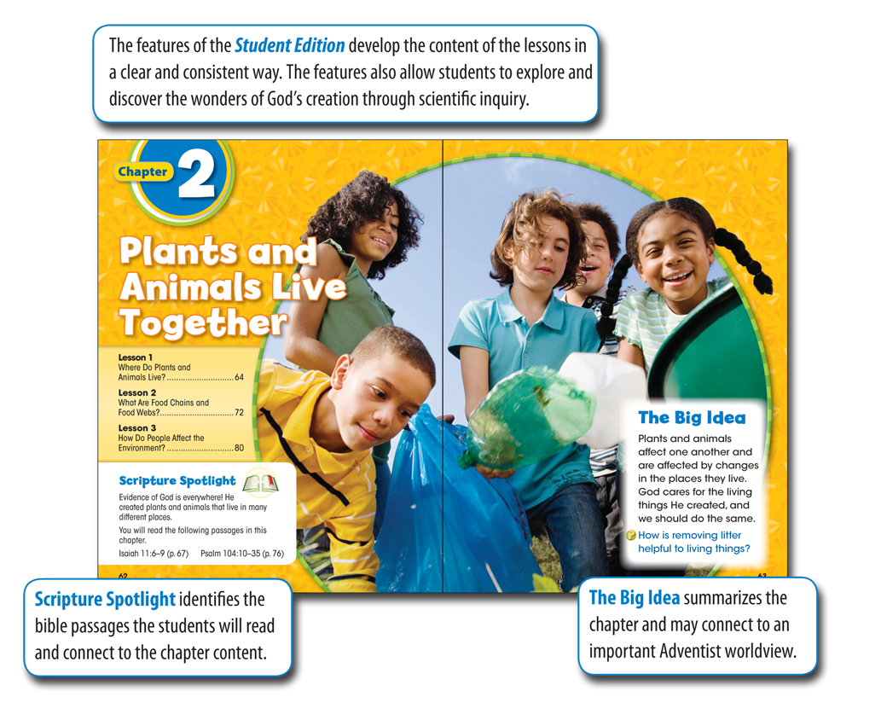
Notes:
Pick up sample pages from TM page # xvi

Slide 16
Notes:
Pick up samples on pages from Training Manual xvii. As well as call outs

Slide 17
Notes:
Pick up samples on pages from Training Manual xvii. As well as call outs

Slide 18
Notes:
Pick up samples on pages from Training Manual xviii. As well as call outs

Slide 19
Notes:
Change Connection to Linkl

Slide 20
Notes:
Pick up samples on pages from Training Manual xix. As well as call outs

Slide 21
Notes:
Pick up samples on pages from Training Manual xix. As well as call outs

Slide 22
By Design Science for Grades 1-8
Student Science Journal
The Student Science Journal is an integral component of the program. It is used as a recording device for the scientific inquiries presented in the Student Edition, and also provides additional inquiry labs and information on critical concepts and worldviews.

Slide 23
By Design Science for Grades 1-8
Each Science Journal becomes an individual record and journal of student's work throughout each unit of study. Also included, at the beginning of the units are the Life Style Challenges and open unit inquiries that span the duration of the unit being studied.

Slide 24
By Design Science for Grades 1-8
There is also a faith and home connection for each chapter. Students will record and journal about their understanding of the lesson content and how this relates to their Adventist education and faith. Each Student Science Journal ends with an end of the unit review used to assess and summarize what students have learned.

Slide 25
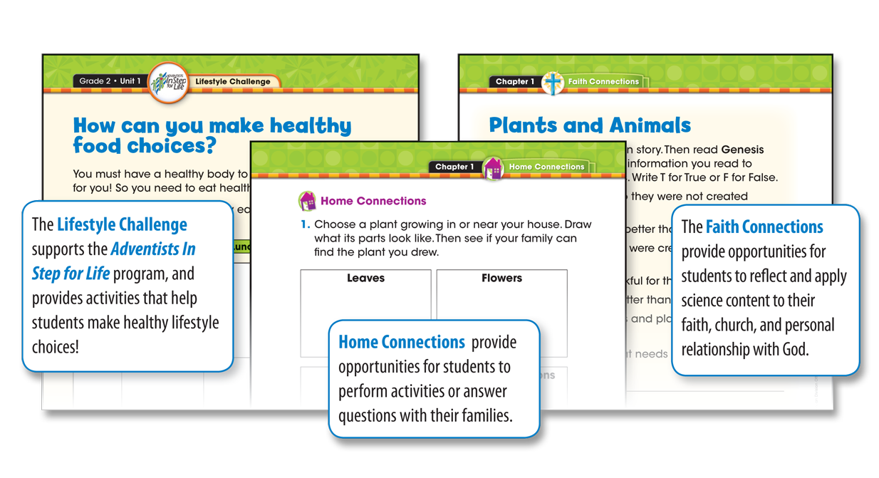

Slide 26
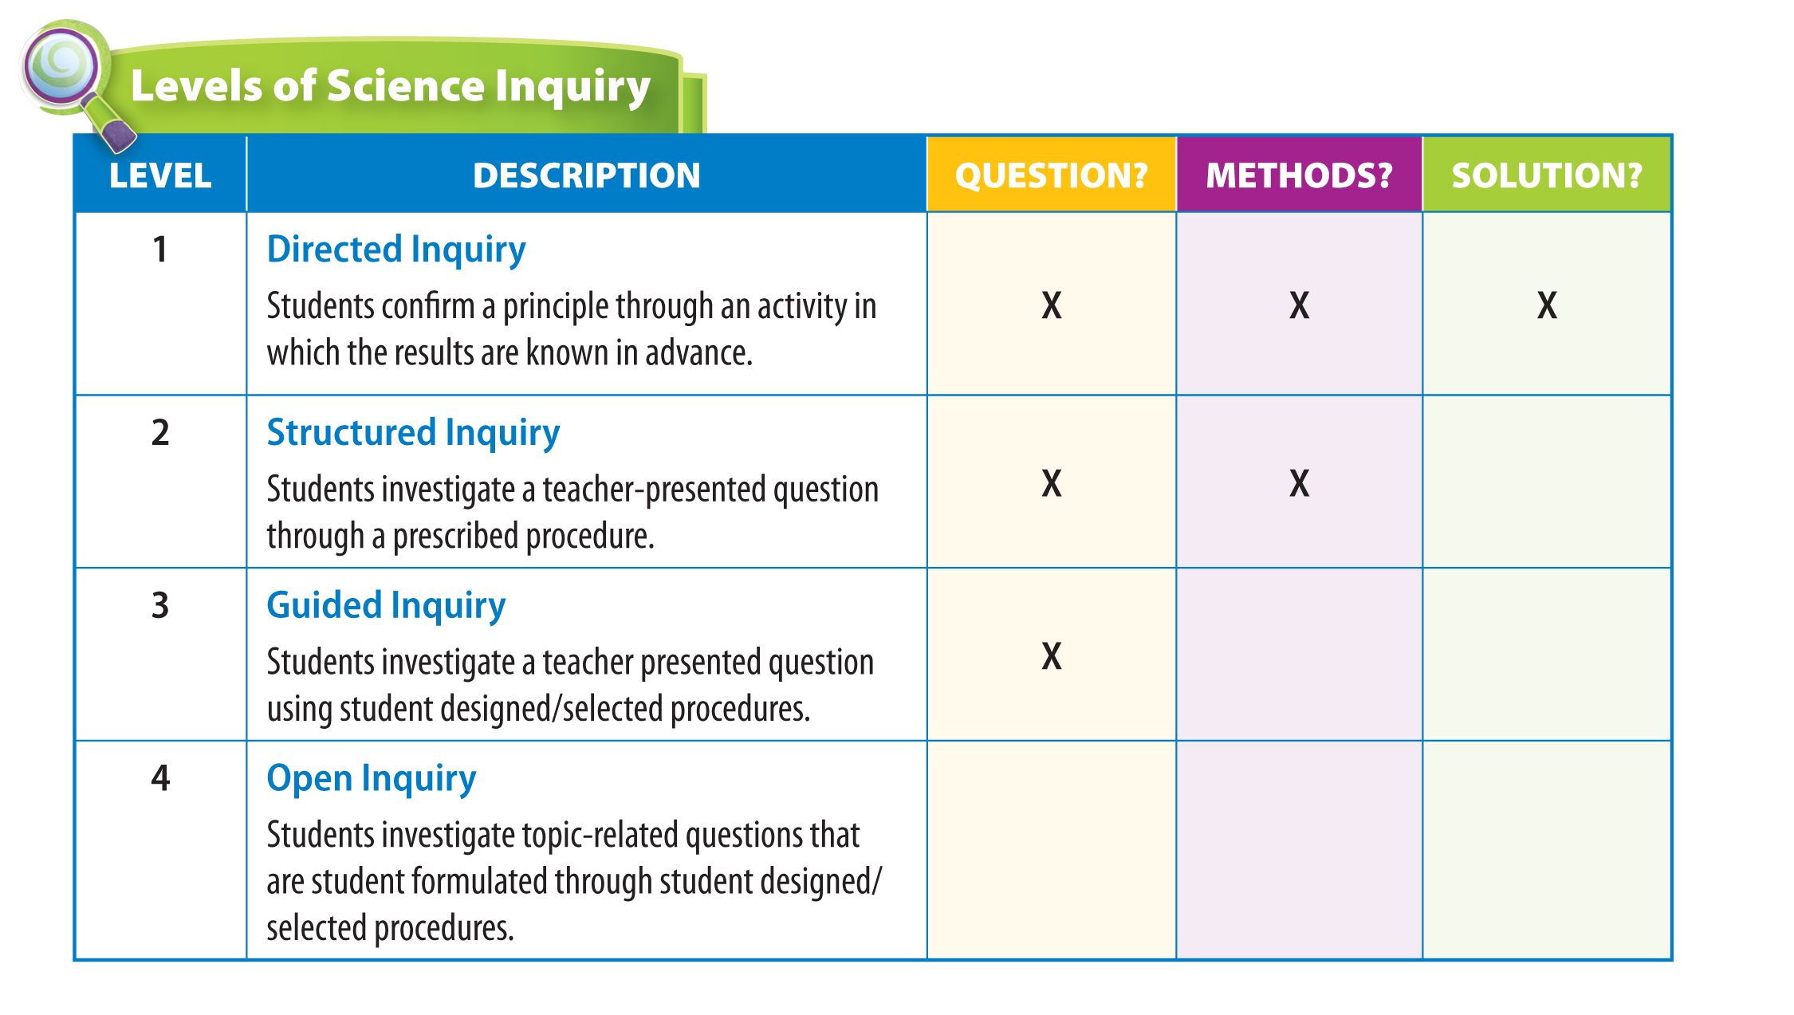
Levels of Inquiry

Slide 27
Overview of The Core of Adventist Education Curriculum
This framework includes four overlapping stages, which align with the four stages of A Journey to Excellence:
Purpose What is the Adventist worldview?
Plan How can the curriculum reflect this worldview?
Practice How can instruction reflect this worldview?
Product How can assessment reflect this worldview?

Slide 28
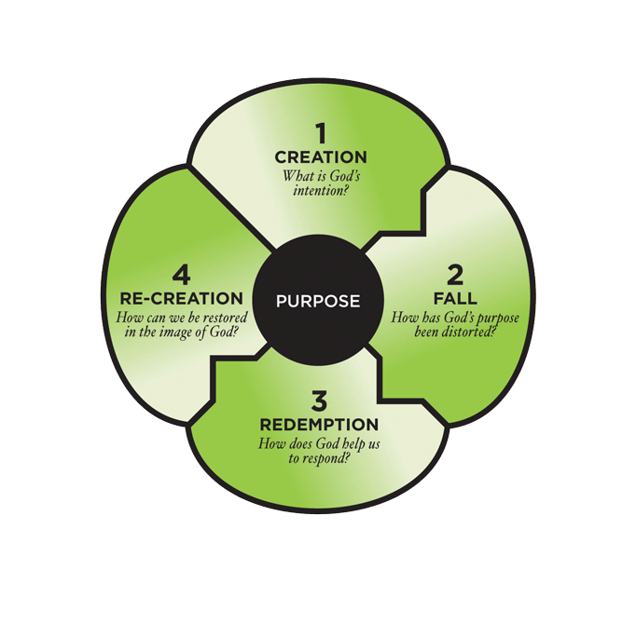
Adventist Worldview
“Our students need a conceptual framework that ties everything together, enabling them to understand themselves, their world, and their place in it” (Krainer, 2011, p. 13)

Slide 29
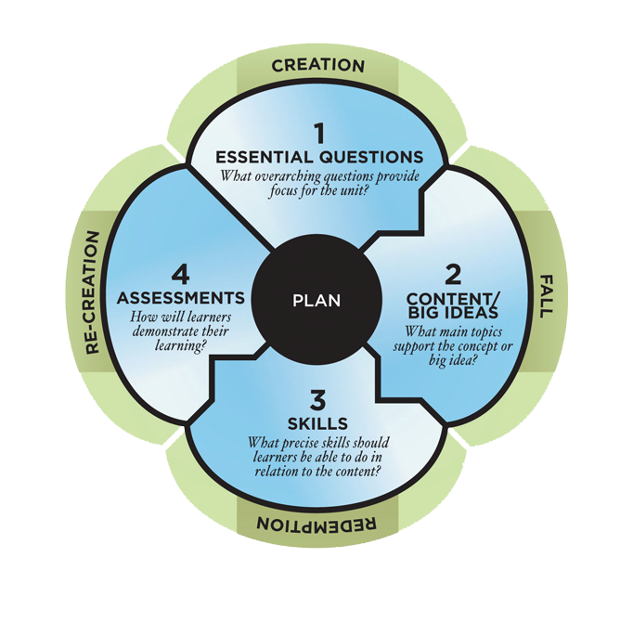
Curriculum
“…every subject area should be taught from a solidly biblical perspective so that students grasp the interconnections among the disciplines, discovering for themselves that all truth is God’s truth” (Pearcey, 2004, p. 129)

Slide 30
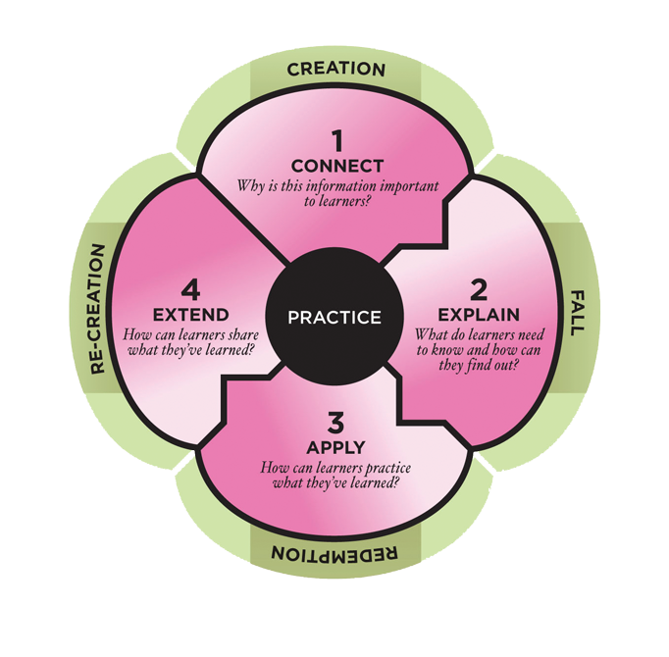
Instruction
“The greatest care should be taken in the education of youth to so vary the manner of instruction as to call forth the high and noble
powers of the mind” (White, 1875, p. 131)

Slide 31
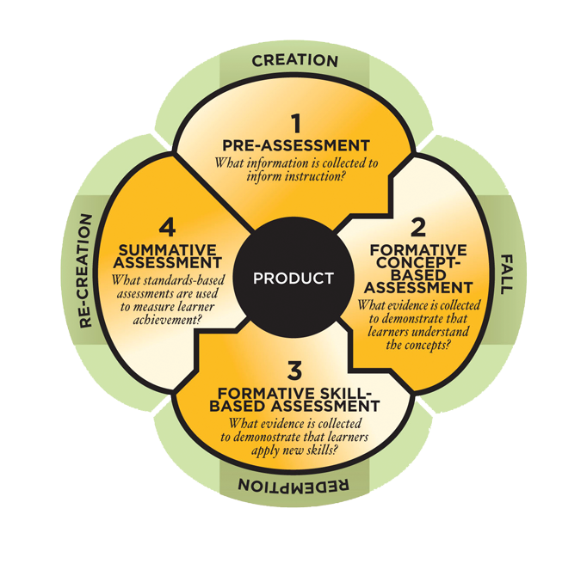
Assessment
“If you don’t change assessment, nothing changes” (McCarthy, 2009, p. 66)

Slide 32
By Design Science for Grades 1-8
Teacher Edition
The Teacher Edition maps you through the 5-step instructional model in a detailed and consistent way. Each step in the model is clearly delineated and includes carefully and thoughtfully developed suggestions for instructional techniques and classroom questioning to invoke scientific and higher order thinking and encourage student curiosity.

Slide 33
By Design Science for Grades 1-8
The Unit Opener provides suggested questions and ideas to introduce the unit content as well as an introduction to the recommended Lifestyle Challenge. You will also find the suggested Unit Inquiry descriptions and support under Teach Using Inquiry.

Slide 34
By Design Science for Grades 1-8
Thoughtful teacher support has been developed along with the student materials and wraps the reduced Student Edition for ease of reference and clear mapping of instruction. The instructional mapping includes sample answers to all questions posed in the Student Edition, including all Math in Science and Explore-a-Lab features.

Slide 35
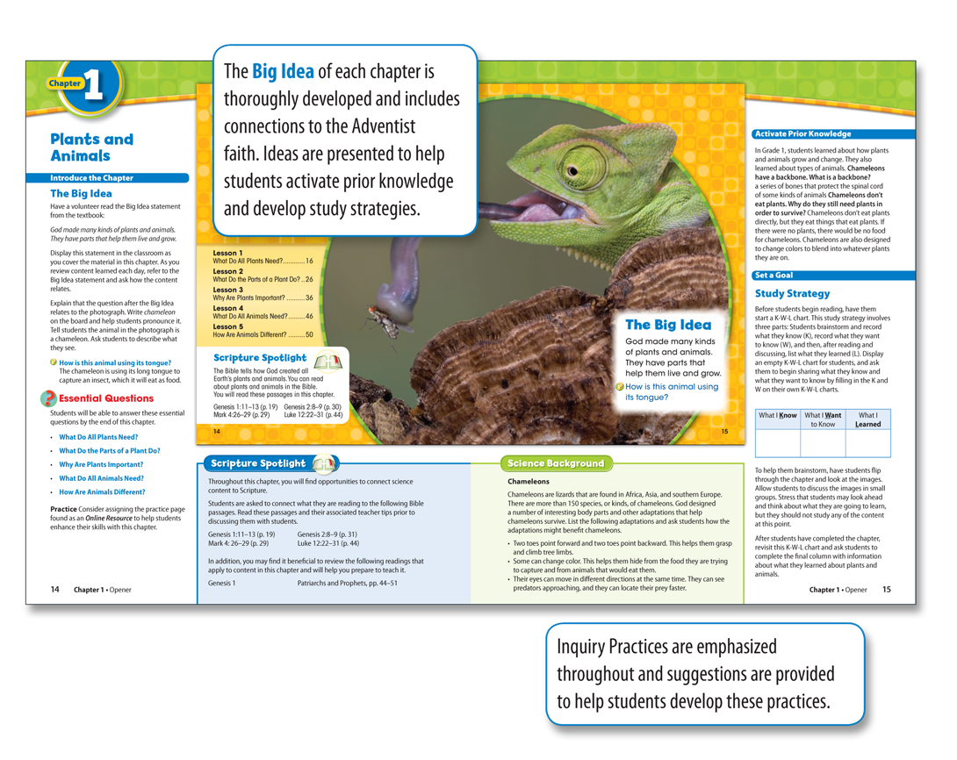

Slide 36
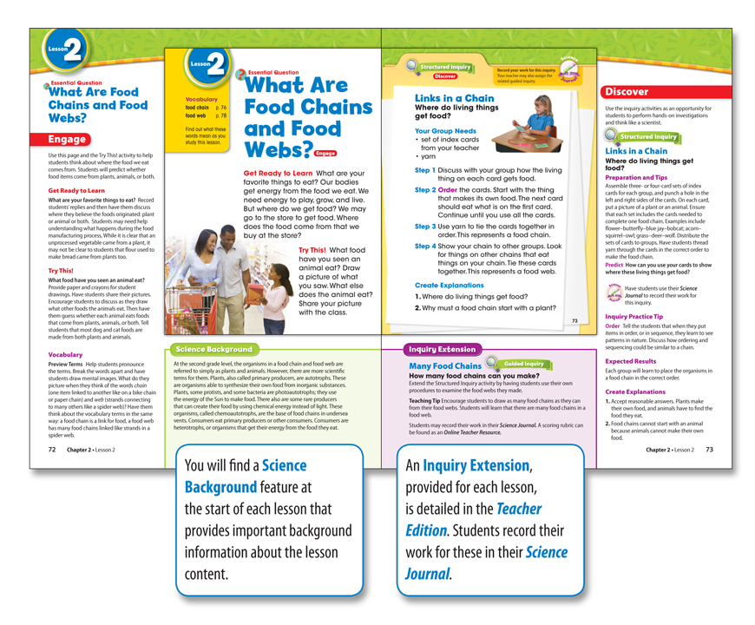

Slide 37
Additional Inquiry Activity

Slide 38
By Design Science for Grades 1-8
Additional Teacher Resources
The Online Teacher Resources provide the details needed for lesson support and additional blackline masters for practice and skill development. These resources include: Lesson support for students, additional practice for students, premade chapter test, and professional development resources for teachers.

Slide 39
By Design Science for Grades 1-8
The Online Assessment Generator provides all formal assessments available through an online assessment tool. This includes publisher-quality question banks that you may use to customize practice worksheets, quizzes, and tests by lesson, chapter, or unit. These may be used as informal or formal assessments and meets the specific needs of your students and your classroom. Additionally, the Online Assessment Tool will include complete, ready-to-use Chapter Tests.

Slide 40
By Design Science for Grades 1-8
Each grade level Kit contains the items you will need to complete the inquiry labs in your classroom! These kits ensure that you are prepared for inquiry activities throughout the lesson and that the materials used are safe for all students.

Slide 41
By Design Science Multi-Grade Classroom
Teacher Guide
The By Design program provides resources for the multi-grade teacher. The resources align the topics across grades 1-4 and grades 5-8, allowing a teacher with multi-grade combinations to teach the same topic across grade levels. This is accomplished by rotating instructional topics through a four year cycle.

Slide 42
By Design Science Multi-Grade Classroom
Student Science Journal
Student materials include 16 Science Journals with one Science Journal per cycle organized by unit for grades 1-4, and 16 Science Journals with one Science Journal per cycle organized by unit for grades 5-8. The customized journals follow the topic alignment chart developed specifically for multi-grade classrooms.

Slide 43
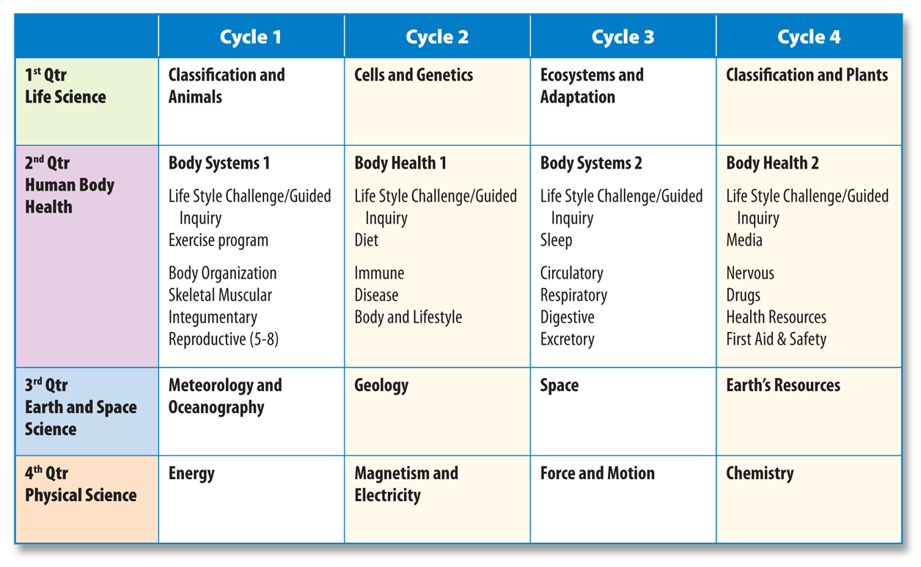
By Design Science Multi-Grade Classroom
Science Curriculum Map

Slide 44
By Design Science Program Feature Icons
Ten Curriculum Goals Support the Unique Philosophy of Adventist Education
Within the content development and the visual design presentation these goals have been blended throughout. Educational skills development such as creative thinking, problem solving, and group collaboration are essential within the educational model. Conceptual understanding will be encouraged through learning observations, talking, asking questions, drawing, and journaling.

Slide 45
By Design Science Program Feature Icons
These three goal are integrated throughout the By Design Science program.
Intellectual Development
Communication Skills
Aesthetic Appreciation

Slide 46
By Design Science Program Feature Icons
Intellectual Development
Each student will adopt a systematic, logical and biblically-based approach to decision making and problem-solving when applied to a developing body of knowledge through the study of science through the lens of the Bible.

Slide 47
By Design Science Program Feature Icons
Communication Skills
Each student will recognize the value and importance of effective communication and develop the requisite skills.

Slide 48
By Design Science Program Feature Icons
Aesthetic Appreciation
Each student will develop an appreciation of the beautiful, both in God’s creation and in human expression, while nurturing individual ability in the fine arts.

Slide 49
By Design Science Program Feature Icons
Scripture Spotlight Bible text or reference that focuses on specific Adventist beliefs and relates to the enduring understandings.
Commitment to Church Each student will desire to know, live and share the message and mission of the Seventh-day Adventist Church.
Scripture Spotlight

Slide 50
By Design Science Program Feature Icons
Biblical Faith Connection Essential questions or concepts that guide in the development of an Adventist worldview.
Acceptance of God Each student will surrender ones whole life to God; develop a relationship with Jesus Christ; and allow the power of God’s word united with the Holy Spirit to work in one’s life.
Interpersonal Relationships Each student will develop a sense of self-worth, skills in inter-personal relationships, an understanding of the responsibilities of family membership and the ability to respond with sensitivity to the needs of others.
Faith Connection

Slide 51
By Design Science Program Feature Icons
Called To Serve Profiles of Christian men, women, and organizations whose lives/mission demonstrate service to humanity in a science-related career.
Career and Service Each student will develop a Christian work ethic with an appreciation for the dignity of service.
Responsible Citizenship Each student will develop an understanding of cultural and historical heritages, affirm a belief in the dignity and worth of others and accept responsibility for local, national and global environments.
Called to Serve

Slide 52
By Design Science Program Feature Icons
Focus on Health Concepts that focus on physical, mental, and spiritual health and relate to the enduring understandings.
Healthy Balanced Living Each student will accept personal responsibility for achieving and maintaining optimum physical, mental and spiritual health.
Personal Management Each student will function responsibly in the everyday world using Christian principles of stewardship, economy and personal management.
Focus on Health

Slide 53
By Design Science Program Feature Icons
Science Journal The Science Journal is used as a recording device for the inquiry activities as well as to summarize important lesson concepts. Additionally, students are asked to journal about their understanding of the lesson and how this relates to their Adventist Education.
Intellectual Development Each student will adopt a systematic, logical and biblically-based approach to decision-making and problem-solving when applied to a developing body of knowledge through the lens of scientific understanding.
Science Journal

Slide 54
By Design Science for Grades 1-8
By Design has a strong foundation based on a 5-step instructional model. This teaching model is used to promote inquiry-based learning and to stimulate a natural desire for knowledge and better understanding of God’s creation.

Slide 55
By Design Science for Grades 1-8
Capture students’ attention and spark their interest
Determine prior knowledge
Focus their attention on the content in the upcoming chapter or lesson

Slide 56
• Capture students’ attention, and spark their interest
• Determine prior knowledge
• Focus their attention on the content in the upcoming lesson.

Slide 57
By Design Science for Grades 1-8
Learning by performing investigations using hands-on activities and scientific methods
Read content and interact to develop scientific literacy

Slide 58
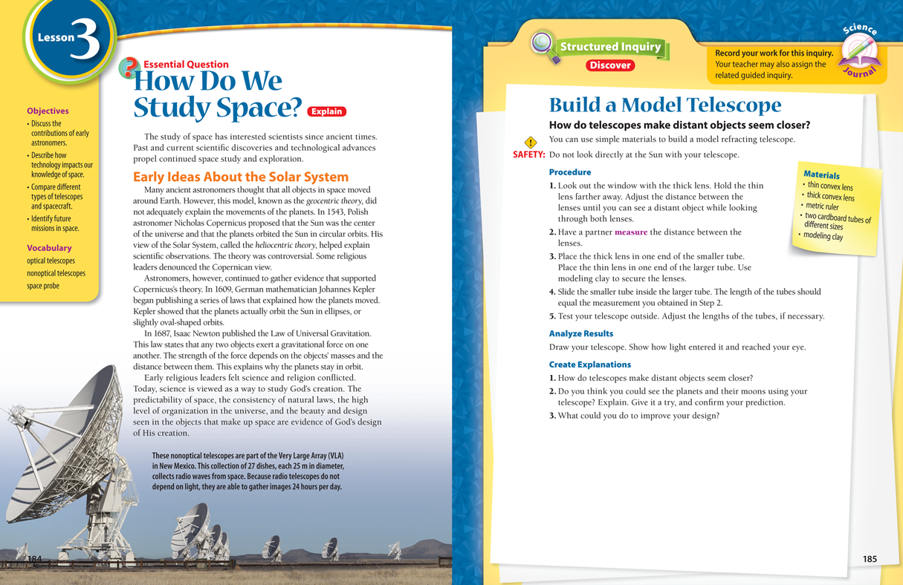
• Read content and interact to develop scientific literacy
• Learning by performing investigations using
hands-on activities and scientific methods

Slide 59
By Design Science for Grades 1-8
Apply the content to other subject areas or study the content in greater depth
Ongoing throughout stages
Formal review of lesson content and demonstrate learning

Slide 60
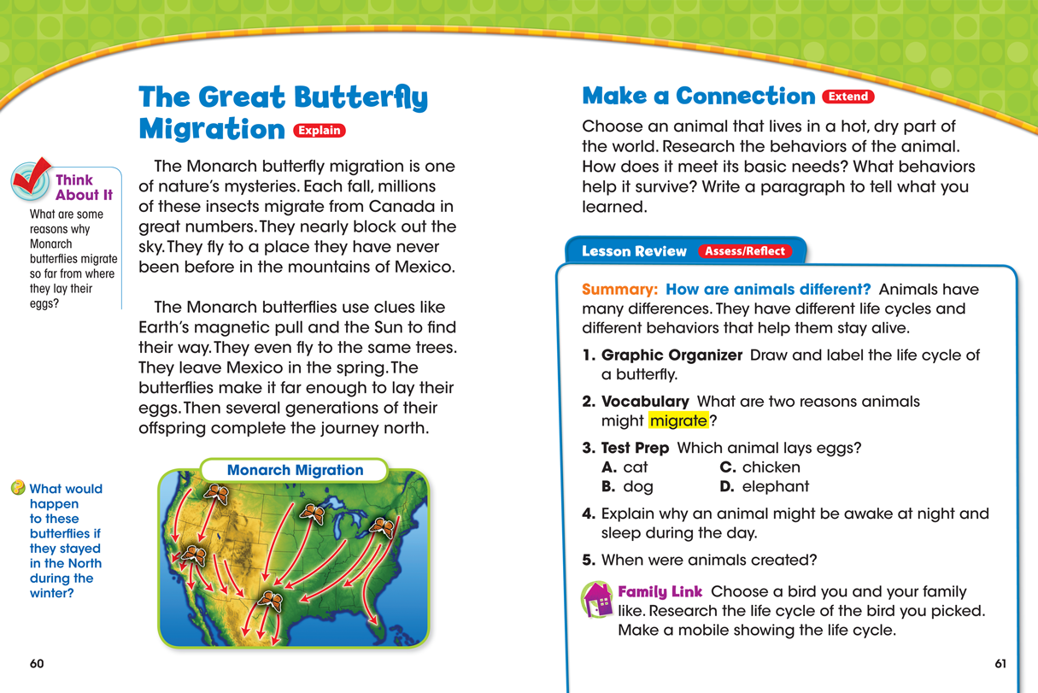
• Apply the content to other subject areas or study the content in greater depth
^{• Ongoing throughout stages}
• Formal review of lesson content and demonstrate learning

Slide 61
By Design: Design Science for Grades 1-8

Slide 62
By Design Inquiry Practices Coverage
There are different forms of inquiry-based learning; but all involve students actively participating in science questioning, investigations, and drawing conclusions for their experiments (activating prior knowledge).

Slide 63
Levels of Inquiry

Slide 64
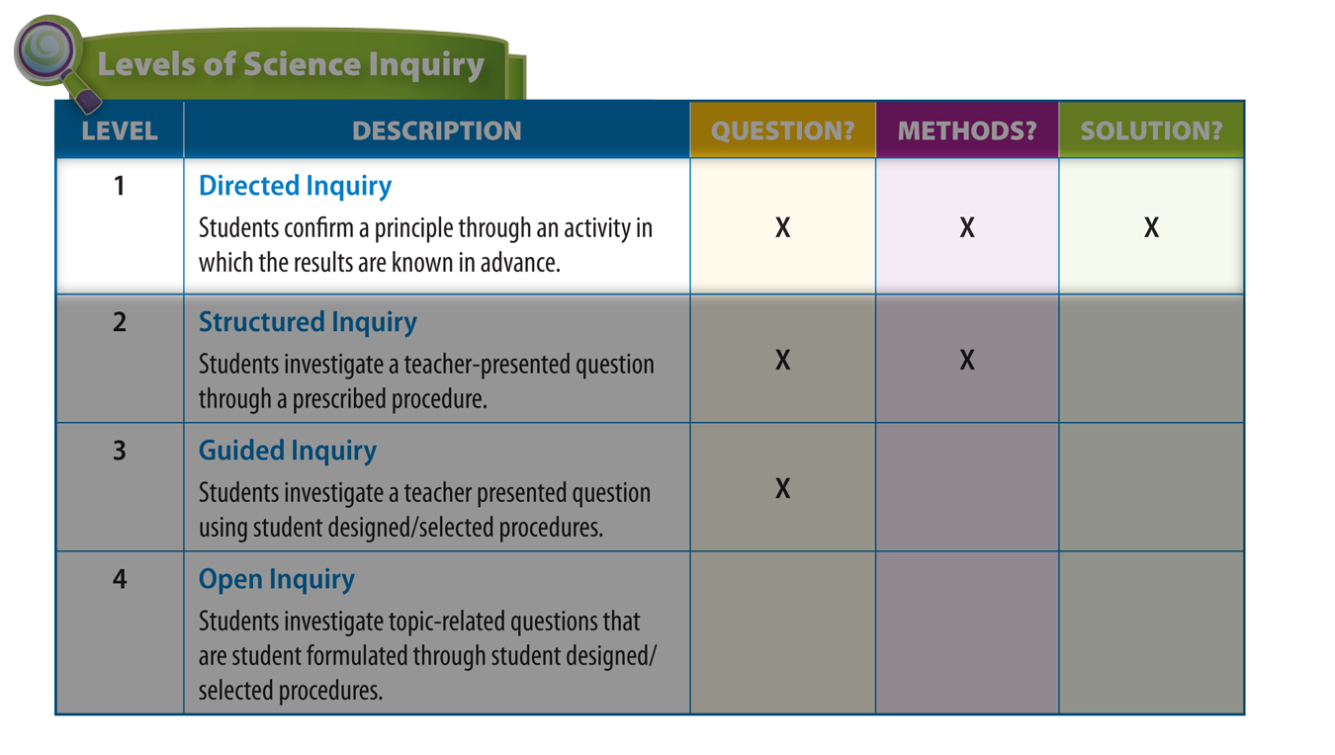
Levels of Inquiry

Slide 65
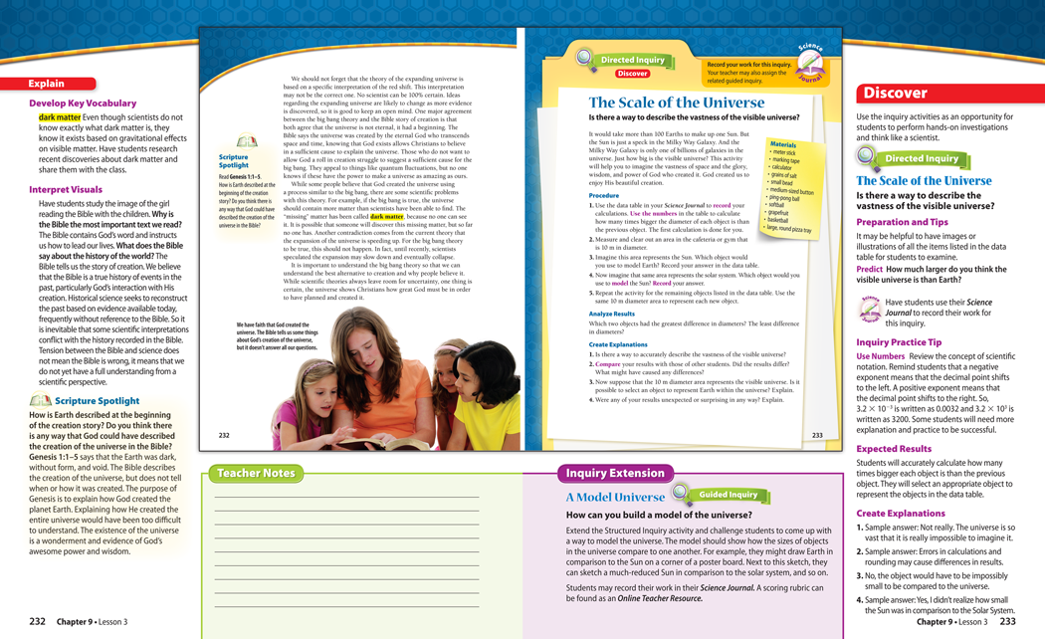
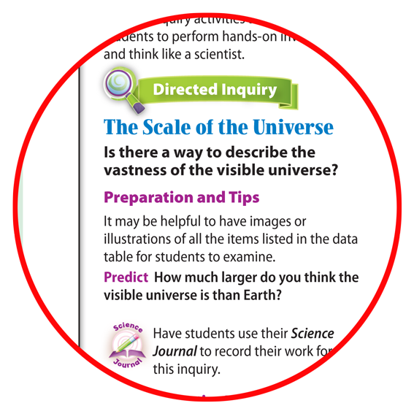

Slide 66
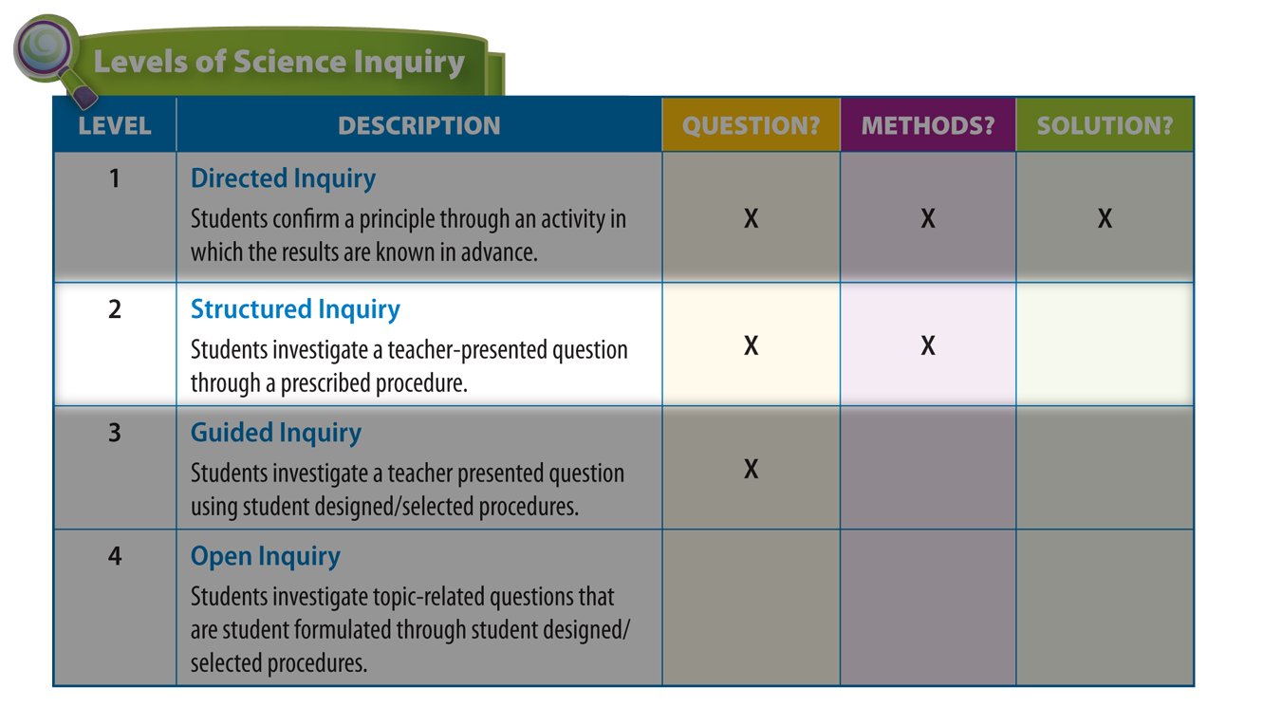
Levels of Inquiry

Slide 67
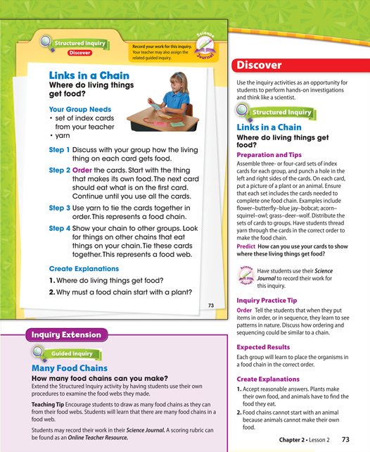
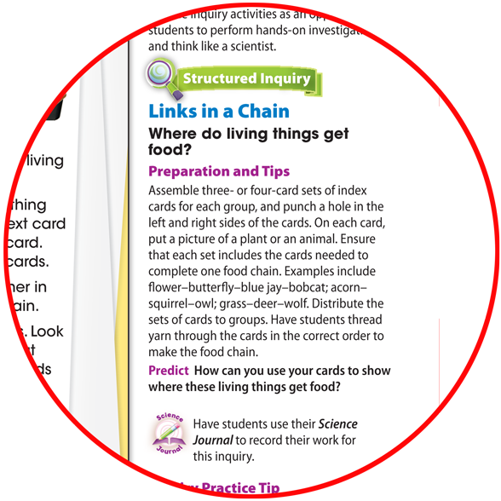

Slide 68
Additional Inquiry Activity

Slide 69
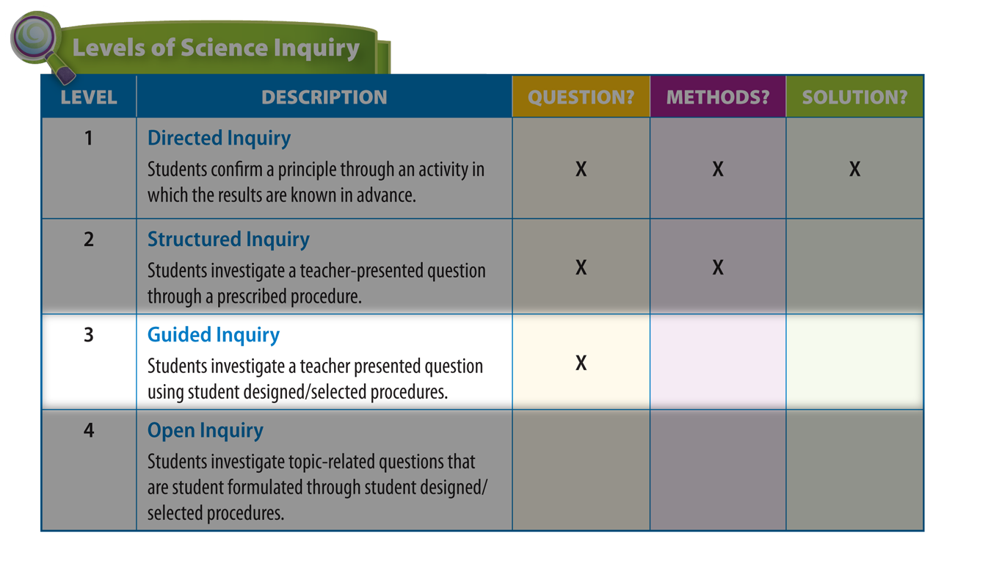
Levels of Inquiry

Slide 70
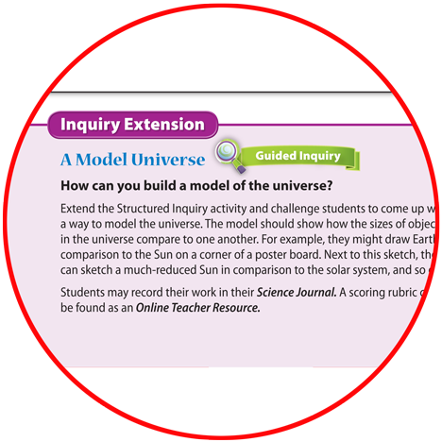

Slide 71
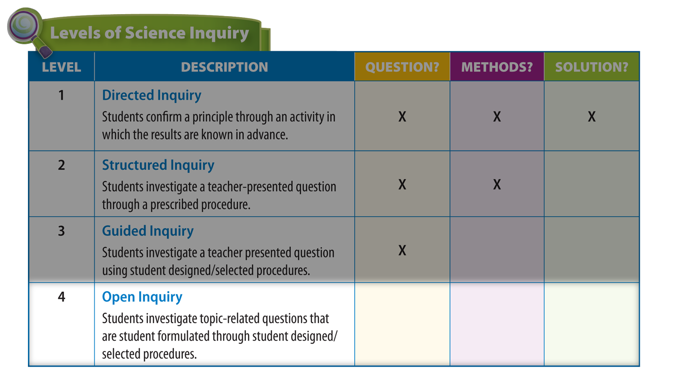
Levels of Inquiry

Slide 73
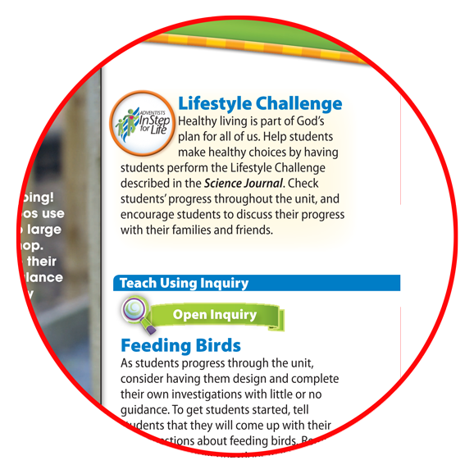
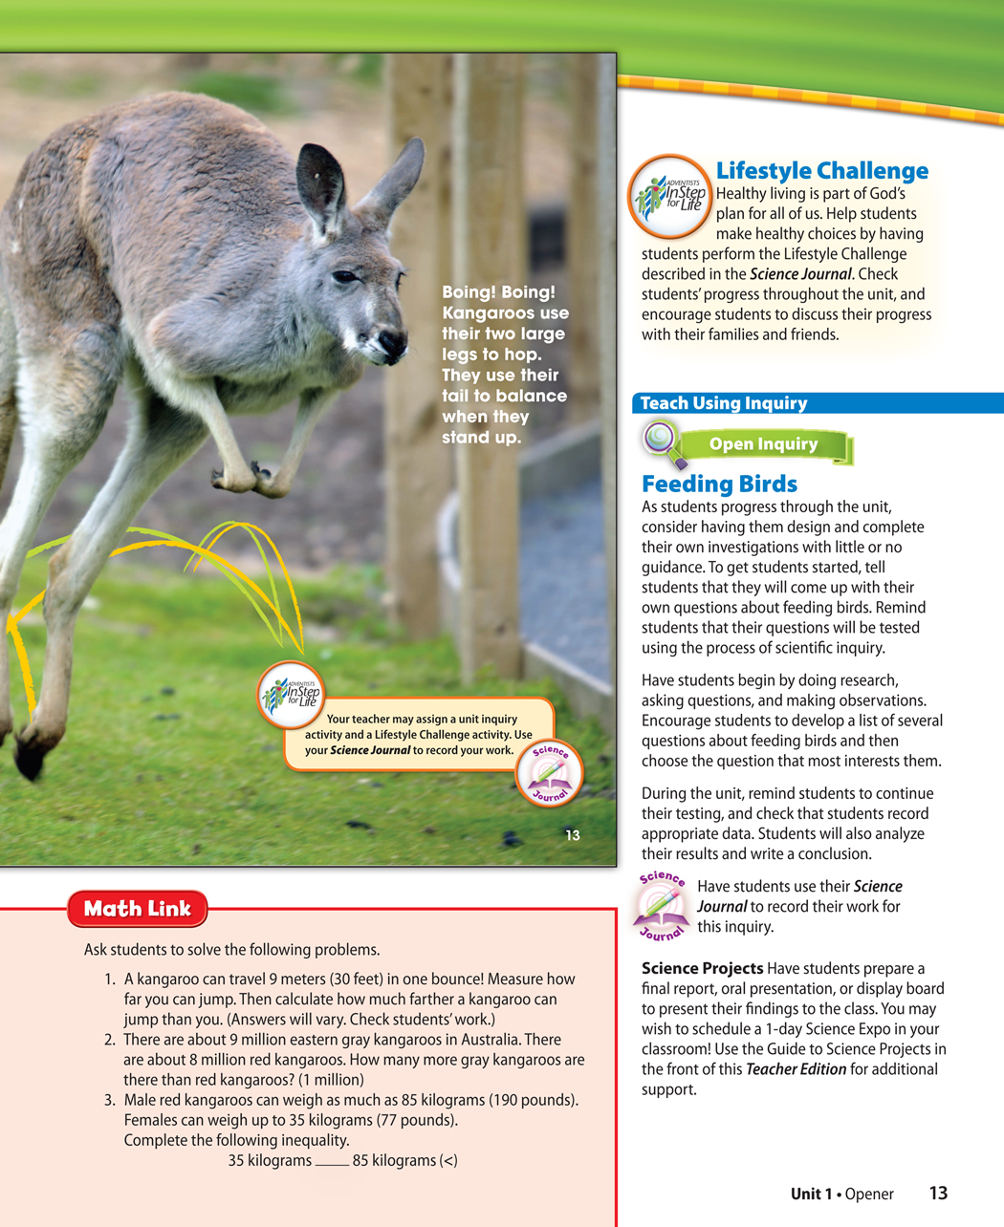

Slide 74
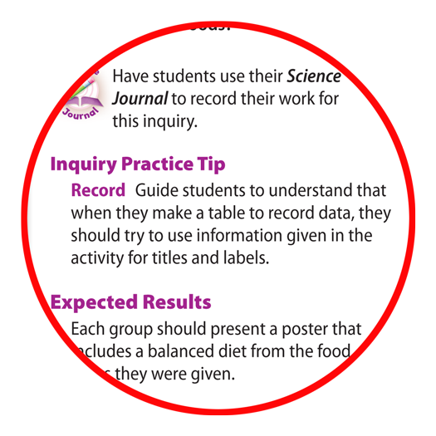
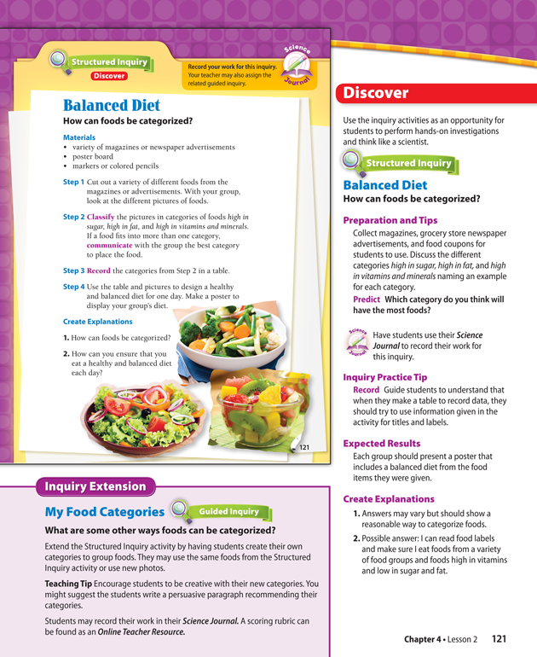
Inquiry Practice Tip- Structured and Directed Inquiry

Slide 75
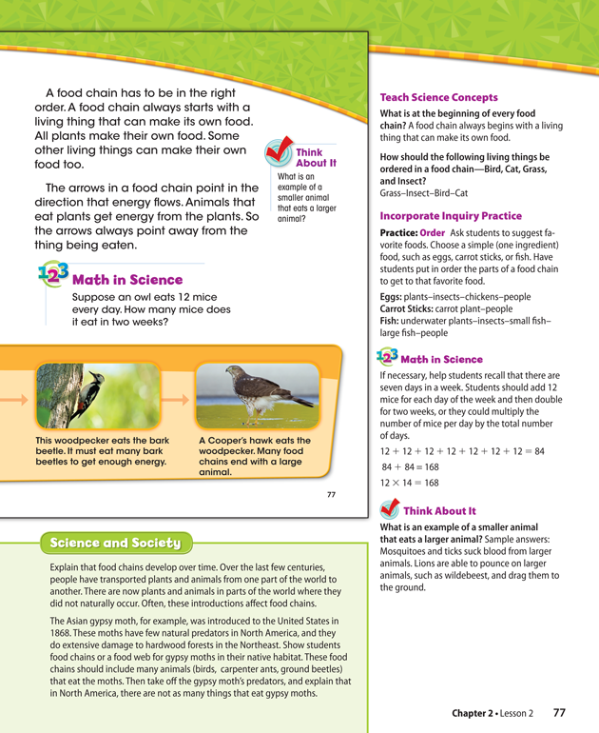
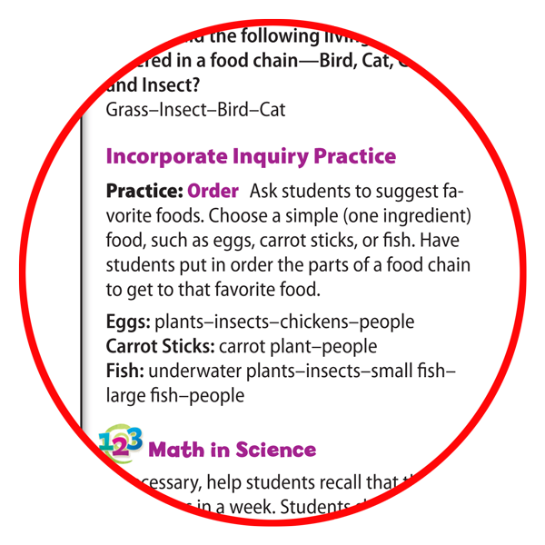
Incorporate Inquiry Practice

Slide 76
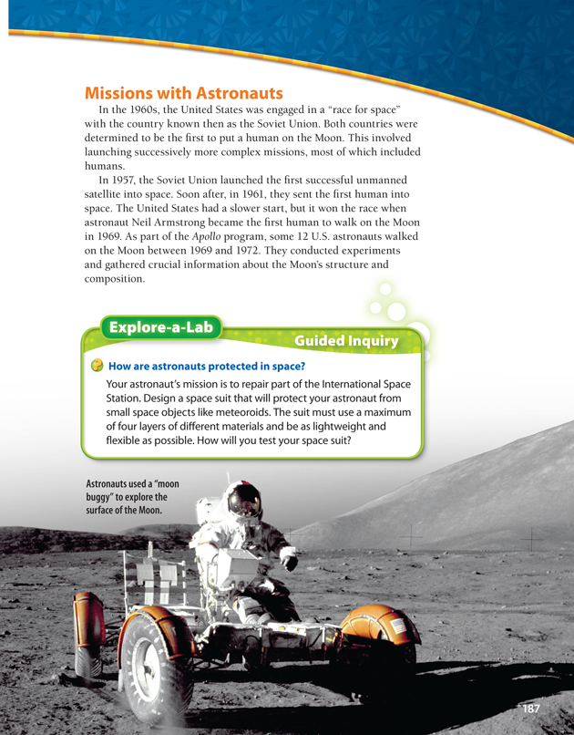
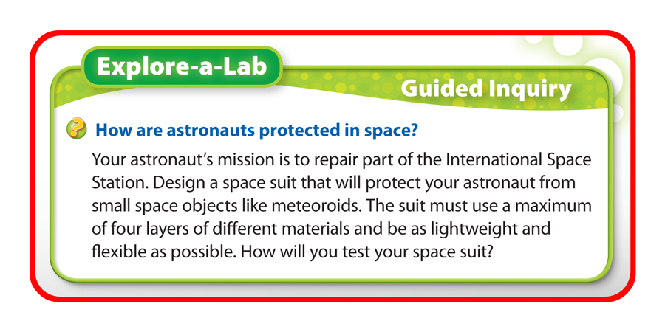
Explore-a-Lab

Slide 77
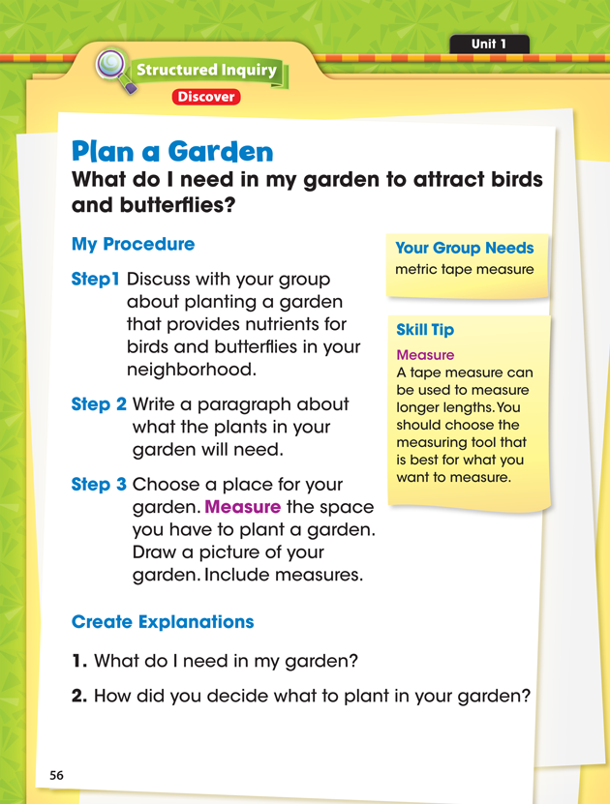
Additional Inquiry Activity (Student Science Journal)

Slide 78
Additional Inquiry Activity

Slide 79
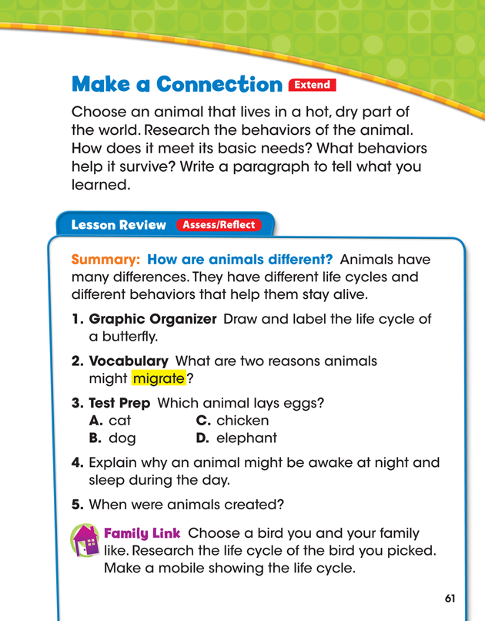
Family Link

Slide 80
By Design Science for Grades 1-8
The Seventh-day Adventist By Design science program empowers educational leaders to embark on a Journey to Excellence. It will be a catalyst to create the future now in Adventist schools.

Slide 81
Notes:
Place Logo/ On background

